Slide 1
FLIGHT PRICE PREDICTION
By:
POOJASHREE d S

Slide 2
Content:
Problem statement
Data pre-processing
Visualization
Model development and evaluation
Conclusions

Slide 3
Problem statement:
Anyone who has booked a flight ticket knows how unexpectedly the prices vary. Airlines use using sophisticated quasi-academic tactics known as "revenue management" or "yield management". The cheapest available ticket for a given date gets more or less expensive over time. This usually happens as an attempt to maximize revenue based on - 1. Time of purchase patterns (making sure last-minute purchases are expensive) 2. Keeping the flight as full as they want it (raising prices on a flight which is filling up in order to reduce sales and hold back inventory for those expensive last-minute expensive purchases) So, if we could inform the travellers with the optimal time to buy their flight tickets based on the historic data and also show them various trends in the airline industry we could help them save money on their travels. This would be a practical implementation of a data analysis, statistics and machine learning techniques to solve a daily problem faced by travellers.

Slide 4
Data pre -processing
The data set consists of 1644 rows and 10 columns
we have to remove unnamo:0 column and I converted the price value which is in string format to float .
The important step in the data peprocessing is to check is there an null value present in the data ..

Slide 5
pandas and NumPy are the basic libraries imported.
Matplotlib.pyplot and seaborn are used for visualization.
Sklearn is used for pre-processing and model building steps.
All algorithms for processing are imported.
Sklearn.metrics will provide the needed evaluation metrics such as accuracy score, classification report and confusion matrix.

Slide 6
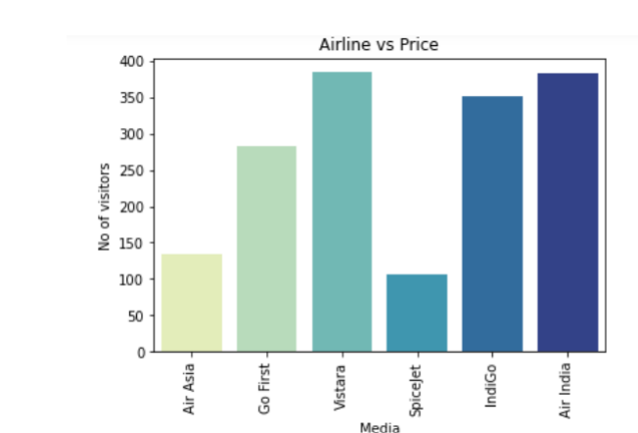
Visualizations:
From the above graph we can able to conclude Air india and Vistara have more number of passengers then others.

Slide 7
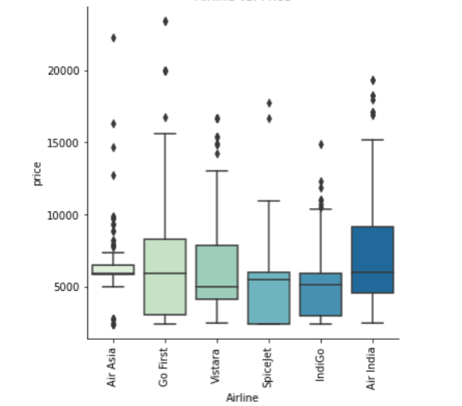
The above graph tells that the Air india have highest price range than the other.

Slide 8
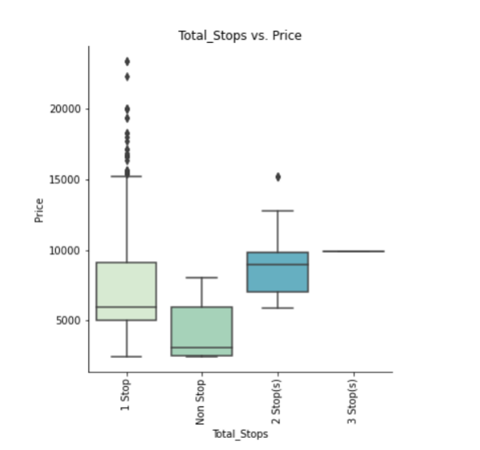
Price of the ticket decreases as the booking is earlier in the present situation December is cheapest because it is after three months

Slide 9
Model development and evaluation:
The data set consists of 1644 rows and 10 columns but we have to remove unnamo:0 column.
I converted the price value which is in string format to float .
The important step in the data peprocessing is to check is there an null value present in the data .

Slide 10
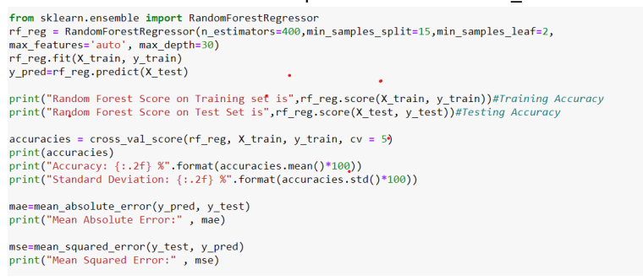
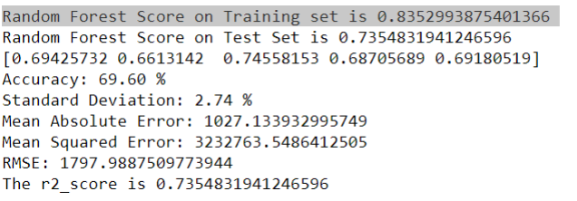
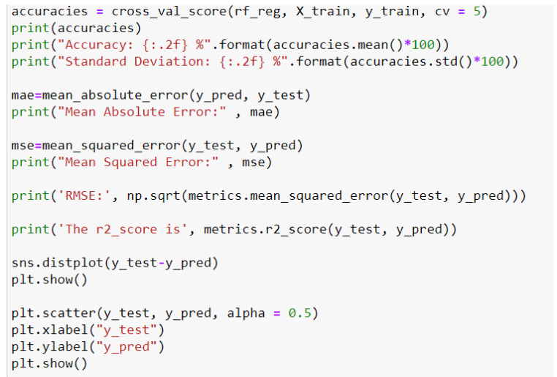

Slide 11
Conclusions:
The aim is to predict the price of the ticket.
Air india and Vistara have more number of passengers then others. Air india have highest price range than the other.
Price of the ticket decreases as the booking is earlier in the present situation December is cheapest because it is after three months

